Slide 1
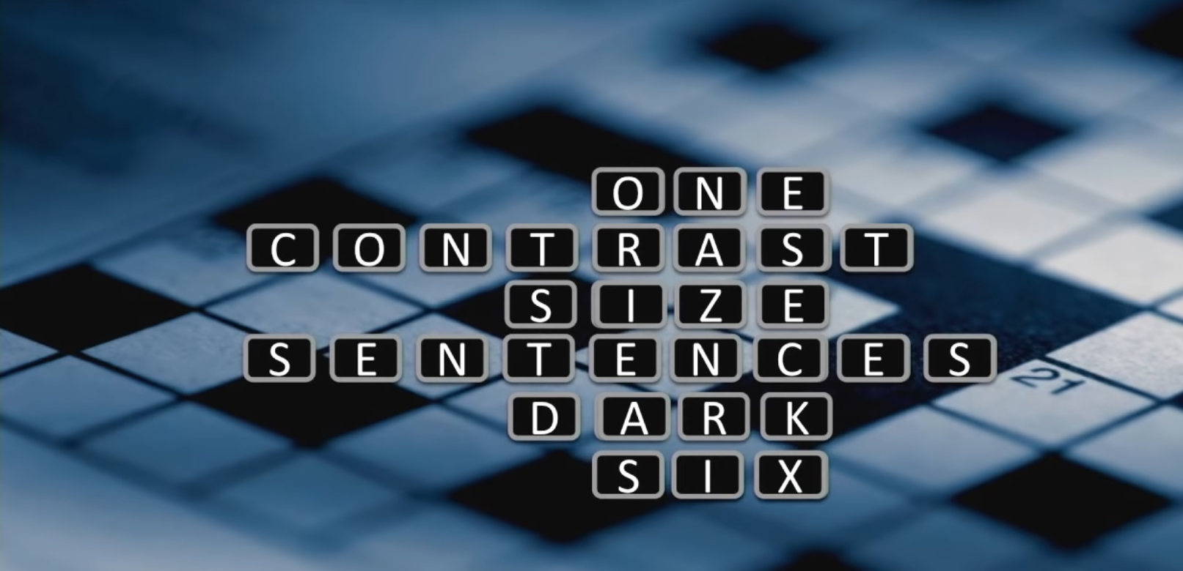
This RTD Template Respects
Stockholm University Neuroscience Guidance
Presentation Optimized for: How to Avoid Death by PowerPoint

Slide 2

Architecture Core Renewal

Slide 3

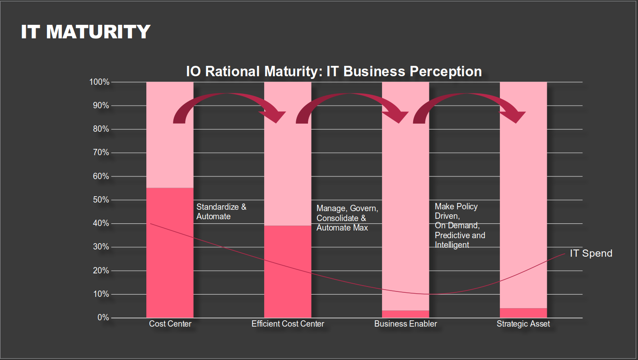
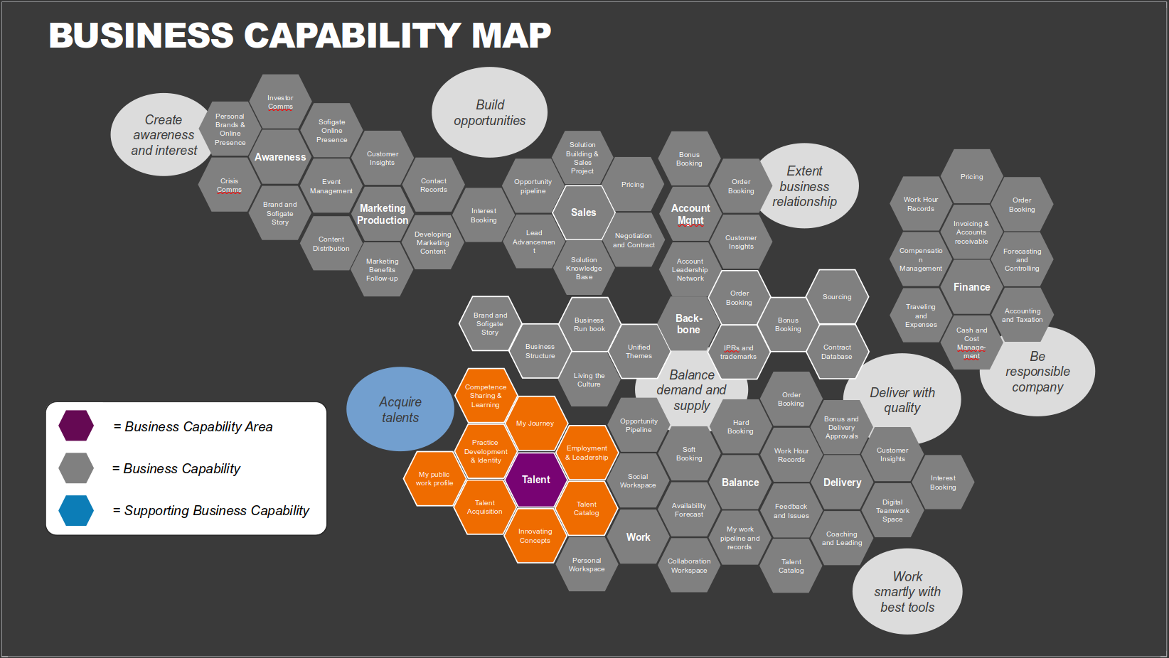
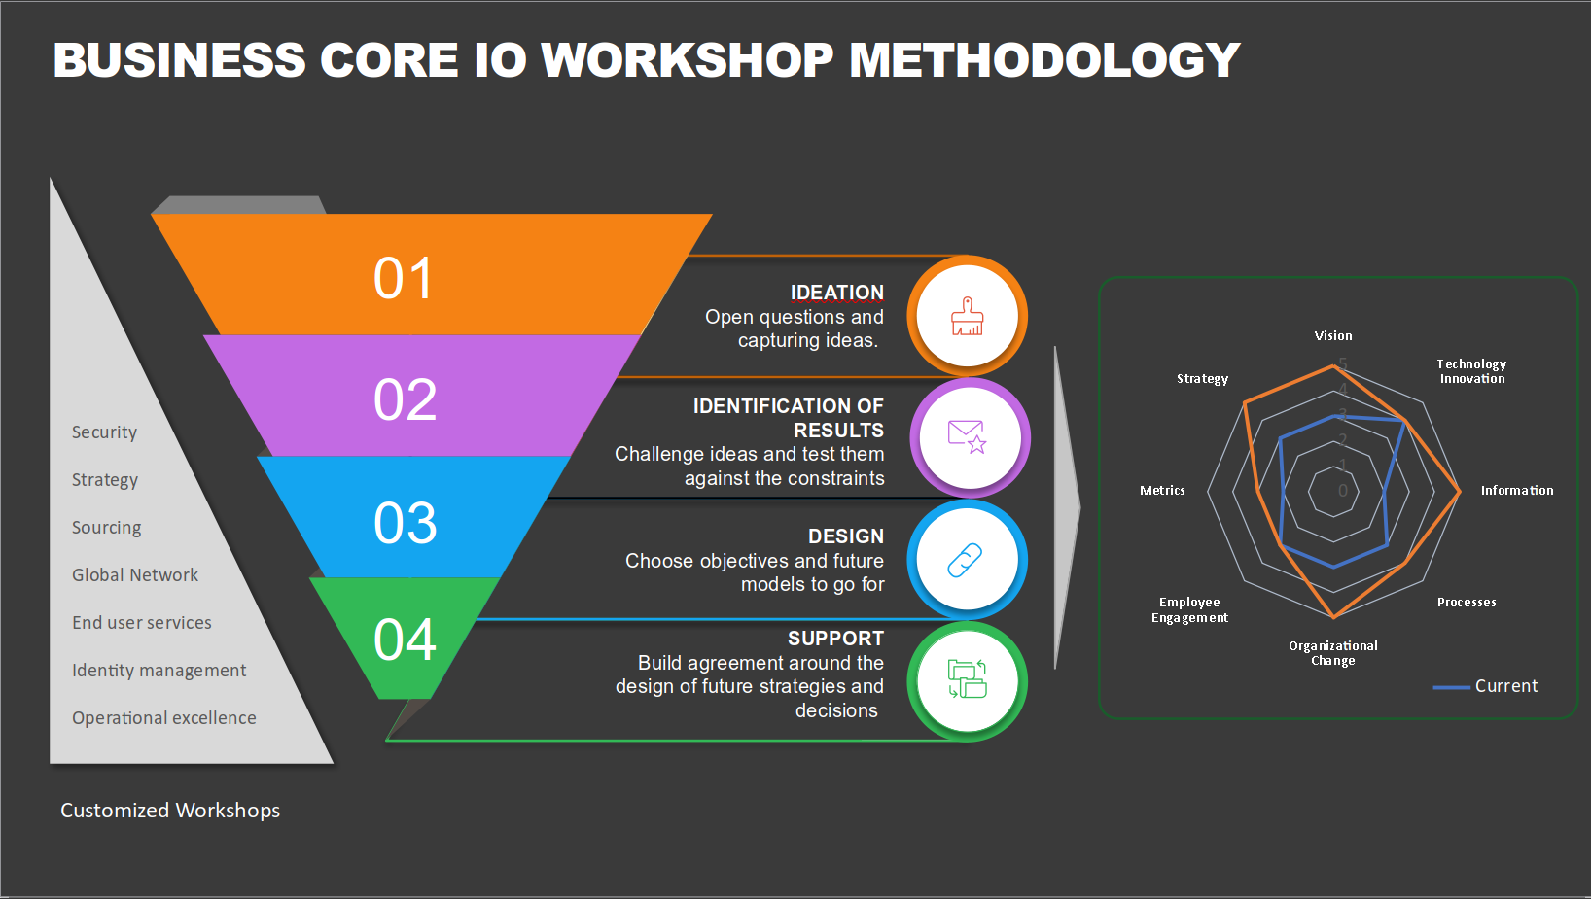
Executive Summary
Steps to reach road map and design
Information Gathering:
Workshops on Business Capability Areas
Workshops on IT Capability Areas
EA Strategy
Analysis:
Review information
Review current design documentation
Apply standards and best practices
Define challenges and solutions
Solution:
Recommendation
Road-map
Define project portfolio scope
Estimate effort

Slide 4


locations
Russia

Slide 5

Project approach

Slide 6
Typical workflow for core IO Pre study
PLAN: Build Road-map
DETAIL DESIGN
Mobilization
Discovery , Define Strategy and Road-map
Anchor Strategy
Technical Workshop Series
Inventory & Validate as-is service portfolio and challenges
Servers, Storage, Network, Facilities, Security etc.
Operations Processes, Maturity and organization
Infra Operating Model and Governance
Sourcing, Partner landscape
Infrastructure Review
Review/Validate
Validate and Verify with Key Stakeholders & SMEs
Confirm assumptions and dependencies
Review risks and mitigation strategy
Finalize
Revise and finalize recommendation based on stakeholders and SME input:
Road-map
High Level Design
High Level Business Case
Execution Plan
Present Final recommendation and next steps.
Target Workplace Architecture Wanted
Define target Service Catalog
Transition and Transformation approach
Target platform
Define Application Delivery Model
Define sourcing options & considerations
Define target cloud operating model
Define target process architecture & maturity
Define target Operating Model required capabilities
Define Cost Model
Business Focused Workshop
Review and Validate Business Requirements (source: material review and workshop)
Review and define business requirements and priorities
Review and define technical requirements & dependencies
Review and define functional (applications etc.) requirements
Mobilize
Prepare
Discovery & Analysis
Define Strategy Implementation Road-map
Prioritize initiatives (waves) w/ time-plan, dependencies & key milestones
Define program governance, setup and flow
Confirm
Objectives
Strategic Workshop
Define Hypothesis for strategic direction
What are the opportunities/barriers for Cloud adoption
What is the list of potential Infra change opportunities & priorities
Define Business Case
Define benefit case supporting strategy
Benefit realization plan
Communication
10 weeks
MONTH 1 | MONTH 2 | MONTH 3

Slide 7
Business Core IO Workshop Methodology
01
IDEATION
Open questions and capturing ideas.
02
Security
Strategy
Sourcing
Global Network
End user services
Identity management
Operational excellence
IDENTIFICATION OF RESULTS
Challenge ideas and test them against the constraints
03
DESIGN
Choose objectives and future models to go for
04
SUPPORT
Build agreement around the design of future strategies and decisions
Customized Workshops

Slide 8
Workshop Outcomes Captured
Areas to cover
Dependencies
Timings
Are these areas dependent on any other areas that one must consider before addressing?
Estimating how long it will take to improve, or innovate the areas defined to reach to your desired future state?
What could be potential areas to cover
Capabilities
Tooling
What kind of capabilities are required to address the areas identified.
What kind of tooling will be required to address the areas.
Notes:
© Copyright PresentationGo.com – The free PowerPoint library

Slide 9
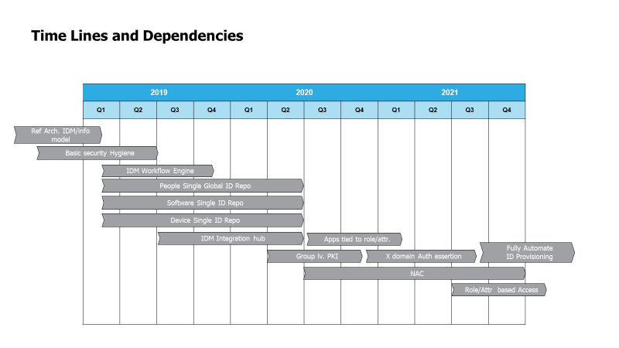
DIGITAL TRANSFORMATION ROAD MAP
Fundamental
Comprehensive
Transformational
IDM + HR Integration
IDM full deployment integration
Comprehensive Service Integration
Identity
Global IDM
In Place
CIS 20 Foundational Baseline
0 Touch Automation
Global Network
Basic Security Hygiene
Cloud based
Global Virtualized ORG
Light Touch Automation
Security
Attributes mapped to tooling
Global VDI + Terminal Services
ORG Streamline
Provisioning
Application Packaging 95%
Skills Inventory
Tiered Application
Delivery
Operations and ORG Streamline
Notes:
Based on the relationship between technical dependencies and the complexity/scope of changes to be made certain basics must be completed before others.

Slide 10
Business capability map
Investor Comms
Build
opportunities
Create awareness and interest
Personal Brands & Online Presence
Sofigate Online Presence
Awareness
Customer Insights
Solution Building & Sales
Project
Bonus Booking
Extent business relationship
Pricing
Crisis Comms
Event Management
Contact Records
Opportunity pipeline
Pricing
Order Booking
Brand and Sofigate Story
Marketing
Production
Interest Booking
Sales
Account
Mgmt
Work Hour Records
Order
Booking
Content Distribution
Developing Marketing Content
Lead Advancement
Negotiation and Contract
Customer Insights
Invoicing & Accounts receivable
Marketing Benefits Follow-up
Solution Knowledge Base
Account Leadership Network
Compensation Management
Forecasting and Controlling
Order
Booking
Sourcing
Finance
Brand and Sofigate Story
Business Run book
Back-bone
Bonus Booking
Traveling and Expenses
Accounting and Taxation
Business Structure
Unified Themes
IPRs and trademarks
Contract Database
Cash and Cost Manage-ment
Be responsible company
Living the Culture
Balance demand and supply
Deliver with quality
Acquire
talents
Competence Sharing & Learning
Order
Booking
My Journey
Opportunity Pipeline
Hard Booking
Bonus and Delivery Approvals
= Business Capability Area
Practice Development & Identity
Employment& Leadership
Soft
Booking
Work Hour Records
Customer Insights
= Business Capability
My public work profile
Talent
Social Workspace
Balance
Delivery
Interest Booking
Talent Acquisition
Talent Catalog
Availability Forecast
Feedback and Issues
Digital Teamwork Space
= Supporting Business Capability
Innovating Concepts
Work
My work pipeline and records
Coaching and Leading
Personal Workspace
Collaboration Workspace
Talent Catalog
Work smartly with best tools

Slide 11
Strategic Priorities: Example
Target Picture
  Streamlined delivery model
  Optimized Support Structure
  Leverage tiered application model
  Security by design (default position)
  World class business user experience
Guiding Principles
Solution Priorities
Global Solution: Standardization and speed
Tiered application delivery
Simplified endpoints
Global
Global
Streamline: Customize “As much as necessary, as little as possible”
Only if regulatory or to meet specific contractual
Regional
Regional
Target Benefits
Cost Efficient, High-Speed, and Secure
Automate: “As much
as possible”
End User Services &
End Points
End User Services &
End Points
  Speed to market
  Cost optimization
  Stability and trust
  Quality of service
  Cost efficiency
Notes:
To lay out the states based on the scope and based on the current understanding

Slide 12
Technology mapping example
Compliance
Group projects
Simplification
People
Integration
Business benefits
Streamline operations
Regulations
SAP HANA
Common
solutions
Skill set for future IT needs
Clearly defined minimum requirements
Common IT sourcing
Automate operations
Security
O365
Common compliant processes (IT)
COE/Shared services
Standard project approach
Enable future cross site collaboration
Self service
Financial audit
Fix the basics
Common vendors
Communication
Group operationally involved
Enable business Shared service centres
Out sourcing

Slide 13

Rationale

Slide 14
IT Maturity
Standardize & Automate
Manage, Govern, Consolidate &
Automate Max
Make Policy Driven,
On Demand, Predictive and Intelligent
IT Spend

Slide 15
Cloud driven IT Maturity
Workshop Outcome Key Decisions (examples)
Need for "Business Enabler" maturity level to meet the vision and security maturity.
Automated user provisioning
Automated user internal move
Automated configuration management
Automated software deployment
Automated monitoring and reporting
Automated event handling
Easy remote assistance
Local language
CIS 20 Foundational Level
Build & Deployment Process
Software and patch deployment, Mobility, Imaging, Virtualization
Change & Configuration Management
Policy, Access control request, Software configuration, Change control
Access Control Management
Directory services, User provisioning, Directory-based authentication
Capacity Management
System hardware configuration, VM configuration, Performance goals & validation, Linking to Life cycle
Monitoring & System Health
System health statistics, Ability to respond early to system errors, Linking to capacity & Life cycle
Data Integrity Management
Policy, Anti-malware, Firewall, Network protection, Encryption, Quarantine, Backup, Restore, Storage management
Lifecycle Management
Best practice guidance on cost-effective solution design, development, operation, and support

Slide 16
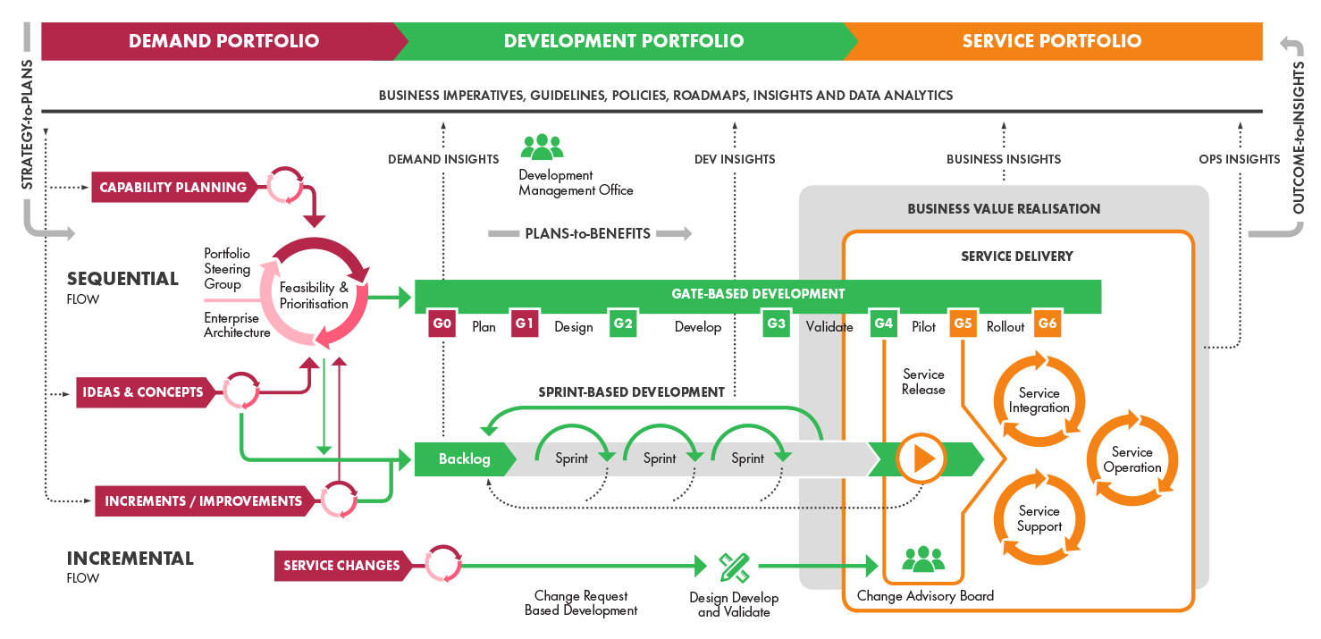
Business Technology Operating model – from idea to service

Slide 17

Deliverables

Slide 18
Deliverable Example
An output will be actionable items.
There will be a list of agreed changes
A high-level project definition and estimate
A recommendation
Notes:
The prestudy will produce a number of decisions and changes that need to be implemented. Though these will be articulated in a formal recommendation document Sofigate will also provide material for decision making. Most changes will be executed as projects and there fore will be expressed as project definitions (of project that need to be done). To assist with decision making high level estimates of cost and effort will be included as well as subjective estimates of complexity, relative effort, risk etc. Having the recommended actions expressed in this way allows leaders to make effective decisions of what changes should be implemented in what order and when.

Slide 19
Deliverable Example
EA Principles are important guides to how to build solutions.
Principles are expressed as a guiding sentence with a rationale and what implications a principle will have.
Reference designs should be coupled to each principle.
Notes:
To be able to guide people and processes in what and how changes should be implemented ongoing, Sofigate will facilitate the creation of a set of enterprise principles that will guide how solutions are implemented, prioritized, and how they are designed. As a follow on step, either internally, or with the assistance of Sofigate, reference architectures also need to be created and linked to all Principles.

Slide 20
Deliverable Example
High Level Business cases covering the changes needed will also be produced as a based for decisions
Benefits will come from several sources when moving from a cost center to business enabler the maturity model
Notes:
The overall project/change benefits must be well understood to allow for making good business decisions. Therefore the prestudy will also deliver overall high level estimates of how the agreed changes will benefit the costs overall. Sharing financial data is therefore important. Financial data on the total cost of IT and how this may be distributed over endpoints and people is important to understand how benefits can be distributed.

Slide 21
Cloud Guiding Principles
Easy Consumption v.s. Control
On Premise
Infrastructure as a Service
Azure VM
Platform as a Service
Azure platform
Software as a Service
Office 365
Applications
Applications
Applications
Applications
Data
Data
Data
Data
Runtime
Runtime
Runtime
Runtime
Middleware
Middleware
Middleware
Middleware
You manage
Service Provider manages
O/S
O/S
O/S
O/S
Virtualization
Virtualization
Virtualization
Virtualization
Servers
Servers
Servers
Servers
Storage
Storage
Storage
Storage
Networking
Networking
Networking
Networking
Cloud flavors: *aaS

Slide 22
Capability map infrastructure example
Business Service Management
Strategy and Business Relationship Management
Service Portfolio Management
Financial Management
Demand Management
Service Catalog Management
Service Level Management
Continuity & Availability Management
Capacity Management
Information Security Management
Governance, Risk & Compliance Management
Supplier Management
Architecture Management
Design Coordination
Service Operations & Support
Systems Management
Cloud Service Models
Core Infrastructure
Transition Planning & Support
Change Management
Service Measurement and Reporting Services
Software (Systems & Applications)
SaaS
Windows Domain Services
Metering & Billing
Migrated Application
Migrated Application
Migrated Application
Migrated Application
Migrated Application
Migrated Application
Collaboration
G-Suite or 365
Directory & Network
Service Validation & Testing
Service Asset & Configuration Management
IT Service Management Services
Name Resolution Services
Customer Reporting
Change Evaluation
Release & Deployment Management
Asset & Configuration Management Services
Platform
PaaS
IP Address Management Services
Orchestration &
Provisioning
Knowledge Management
Fabric Management Services
Migrated Application
Migrated Application
Migrated Application
Migrated Application
Migrated Application
Pre-Boot Execution Environment Services
Deployment and Provisioning Services
Security
Incident & Problem Management
Private Cloud Infrastructure
IaaS
Public Cloud Infrastructure
Health, Security & Performance Monitoring Services
Hypervisor
Digital Certificate Services
Request Fulfillment
Data Protection & Recovery Services
Compute
Network
Storage
Compute
Identity & Access Federation Services
Predictive Operations
Access Management
Network
Security Management Services
Facilities
Security & Access
Remote Access & Console Services
Technical Management
IT Operations & Event Management
Space
Power
Cooling
Storage
Network Management Services
Network Access Protection Services
Application Management
Facilities Management

Slide 23
Capability map workplace Example
Business Service Management
Strategy and Business Relationship Management
Service Portfolio Management
Financial Management
Demand Management
Service Catalog Management
Service Level Management
Continuity & Availability Management
Capacity Management
Information Security Management
Governance, Risk & Compliance Management
Supplier Management
Architecture Management
Design Coordination
Service Operations & Support
Systems Management
Enterprise Digital Workplace Service Model
Core Infrastructure
Transition Planning & Support
Change Management
Service Measurement and Reporting Services
Terminal Services (Citrix)
SaaS
Windows Domain Services
Metering & Billing
Legacy Application
Legacy Application
High Security Application
High Performance Application
Collaboration
Platform
Directory & Network
Service Validation & Testing
Service Asset & Configuration Management
IT Service Management Services
Name Resolution Services
Change Evaluation
Release & Deployment Management
Asset & Configuration Management Services
Office 365
IP Address Management Services
Orchestration &
Provisioning
OS Platform
Application 1
Knowledge Management
Fabric Management Services
Global
Application 1
Local
Application 1
Global
Application 2
Local
Application 2
Local
Application 3
Pre-Boot Execution Environment Services
Application 2
Deployment and Provisioning Services
Security
Incident & Problem Management
Health, Security & Performance Monitoring Services
End point Monitoring
Digital Certificate Services
Request Fulfillment
Security
Monitoring
User Experience
Monitoring
Software
Provisioning Agent
Event
Monitoring
Predictive Operations
Data Protection & Recovery Services
Identity & Access Federation Services
Access Management
Security Management Services
Security & Access
Remote Access & Console Services
Technical Management
IT Operations & Event Management
Standard Hardware Services
Network Management Services
Compute
Network
Storage
Peripheral Device
Printer
Network Access Protection Services
Application Management
Facilities Management

Slide 24
IT Delivery Stack: Infrastructure View of Service Scope
Private Cloud IaaS/SaaS and AM
Public Cloud IaaS and AM
Public Cloud SaaS and AM
Application Maintenance (AM) Application Development (AD)
SAP Application Consulting
Application Consulting
Strategy & Design
Strategy & Design
SAP Application Development & Integration
Application Development & Integration
Development of new applications, major changes, Test,
Development of new applications, major changes (projects), Test, Customizing of Applications to business processes, Consolidation
Customizing of Applications to business processes, Consolidation
s, Migrations
Operation of SAP Application
Functional Application Management
3rd Level Application Support, minor enhancements, Bug fixes
3rd Level Application Support, minor / major enhancements, Bug fixes, profile /User Management, Application Assessment Apps Configuration
profile /User Management Application Assessment Apps Configur
ation interface Mgmt.
Technical (Non-Functional) Application Management
3rd Level Application Support, Dev/Test Environment support, Patches, Environmental Management; Application Technical Documentation Setup Apps Monitoring, Profile /User Management
Software as a service SaaS, Collaboration suites, BI, etc.
Application Operations (AO)
AIS Applications Utility Sourcing
Operation of Application Basis
Service Delivery Management
Application Basic Operations
Less Generic More Generic
3rd Level IT Support
3rd Level IT Support
Administration of Application
---
---
administration of Application
Basis configuration and configuration management
----
Reports
----
Basis configuration
Reports
------
3
3rd Party Integration
Party Integration
------
Basic Performance
Basic Performance
------
Tuning & Optimization
rd
Tuning & Optimization
- Interface monitoring
Application Basics
4a
Application Basics
web Middleware Management
Web/Middleware Management
IT Monitoring IT Help Desk
URL / transaction monitoring,
IT Monitoring IT Help Desk , resolution documentation
transaction monitoring,
Web administration, interface monitoring
Interface documentation
web Administration,
Database Management
Interface monitoring
Infrastructure as a service, containers, VM’s, VDI’s etc.
3
Database Management
DB Administration, Upgrades, Migration Standards and operating documentation,
DB Administration, Upgrades, Migration,
Tuning, Backup & Recovery, Monitoring
Tuning, Backup & Recovery, Monitoring
Infrastructure Operations (IO)
AIS Infrastructure Utility Sourcing
Operating System
Operating System
Server Backup & Restore, Server Administration, Disk migration
s,
2
Server Backup & Restore, Server Administration, Disk migration
OS and Firmware Patches, Monitoring, Software Support
´Virtual infrastructure Support
Configuration management documentation
OS
-
und Firmware Patches, Monitoring, Software Support
Hardware Platform
1
Hardware Platform
Hardware ( Server & Storage) Support Multi
-
vendor Spare
-
und Support mgmt,
Hardware ( Server & Storage) Support, Installation, Decommissioning, Upgrade
Simple Source able components

Slide 25

End of presentation

